Slide 1

VIP 6.0
Team Members: Dafna Steinberg, Jose Ponce Product Owner: Masoud Sadjadi, Francisco Ortega
Instructor: Masoud Sadjadi School of Computing and Information Sciences Florida International University
Final Presentation
Summer 2017
Notes:
7 seconds.( I will select 2 best slides (i will give them extra points and students will present for CIS committee)
Greet your audience, thank them for attending your presentation, introduce yourself, introduce your project, introduce your team members, and quickly indicate what each of you did in a high-level manner, and put more emphasis on your part/contribution.

Slide 2
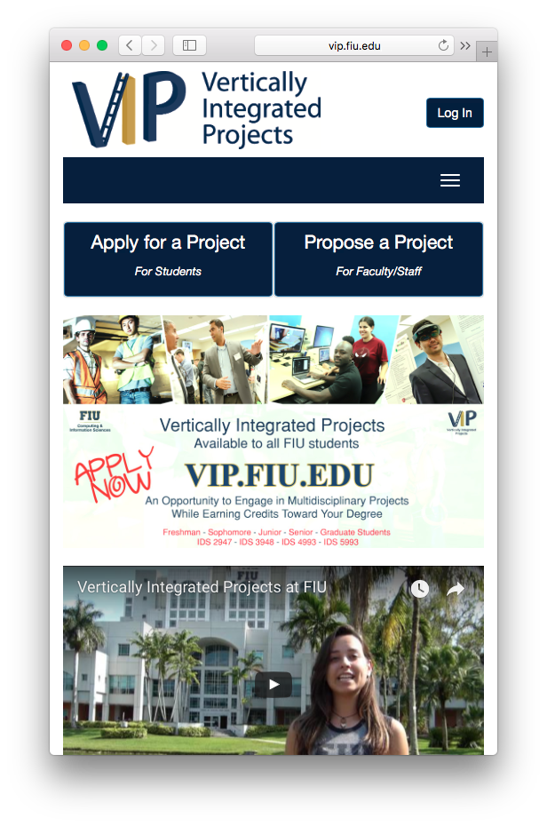
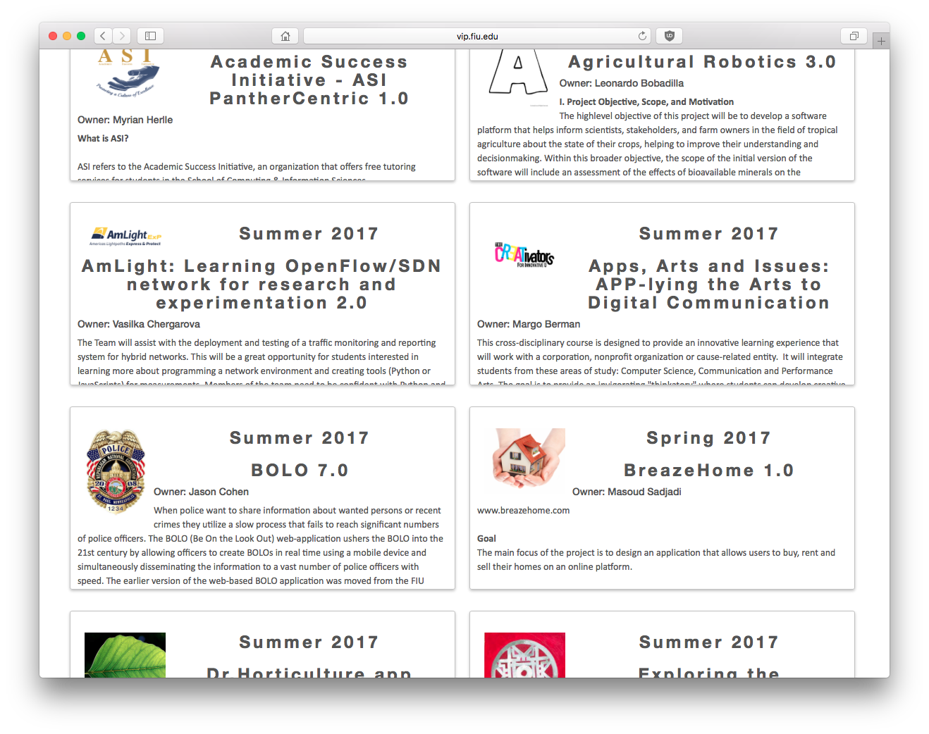
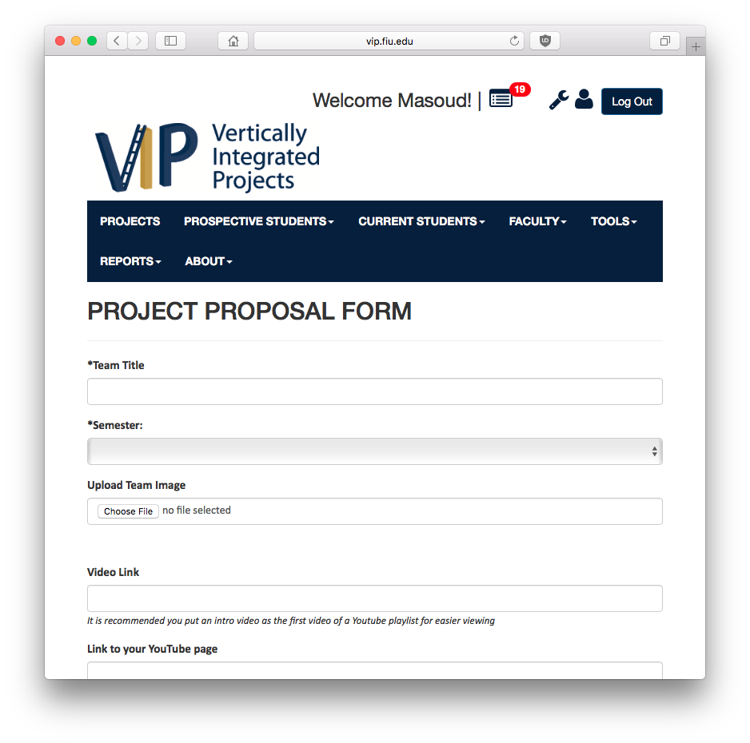
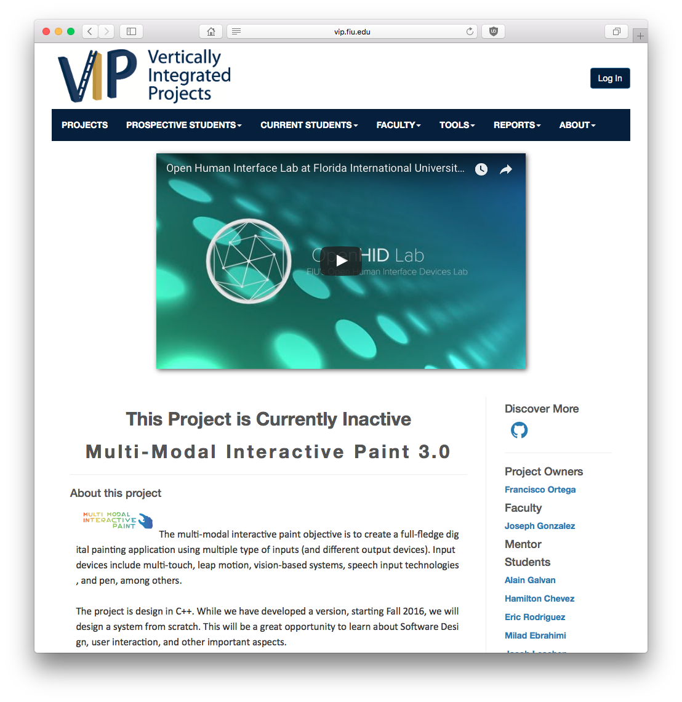
Project definition
Notes:
10 seconds.
Introduce the problem that the whole project (in all versions) tackles with GIF or screenshot.

Slide 3
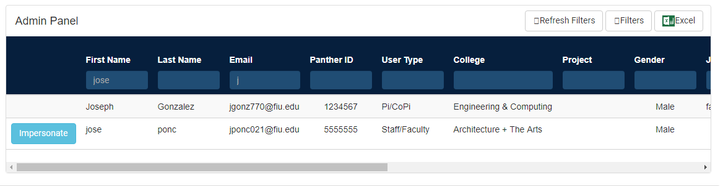
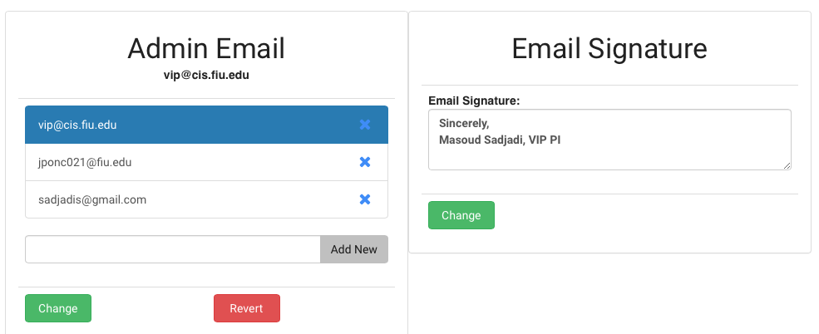
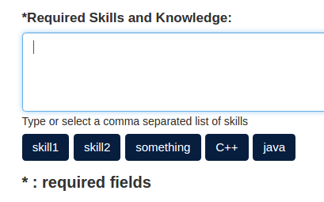
Project definition
Notes:
20 seconds.
Introduce the problem that the your project (in new version) tackles with GIF or screenshot.

Slide 4
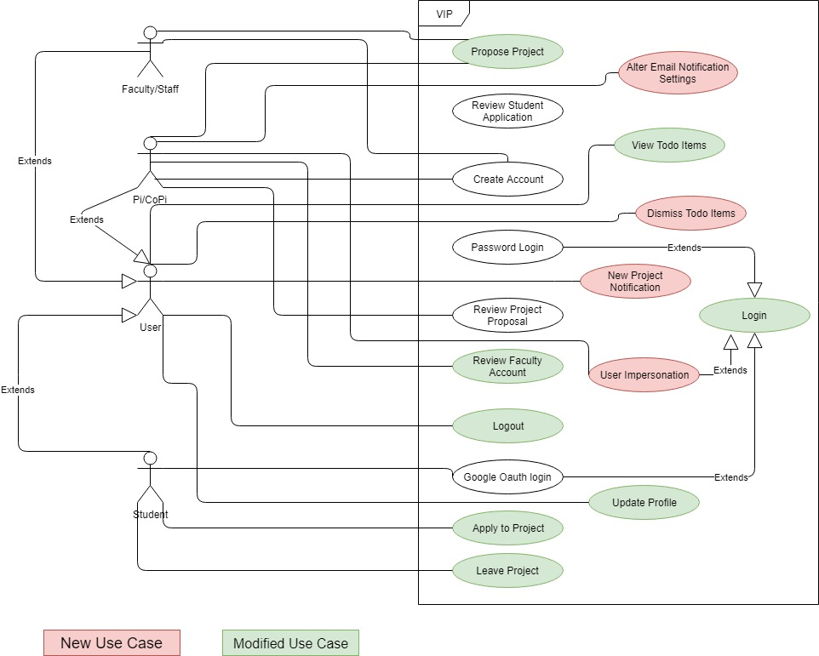
Requirements: Use Cases
Notes:
5 seconds
Show the Use Case Diagram for the whole project. Highlight your use cases.

Slide 5
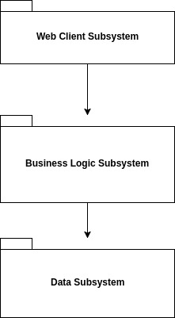
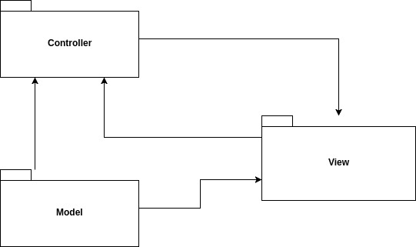
System Design: Architecture
3-Tier Architecture MVC/MVVM
Notes:
20 seconds
System design: Highlight the parts that you contributed to them.
1. System decomposition; identify the architecture patterns used

Slide 6
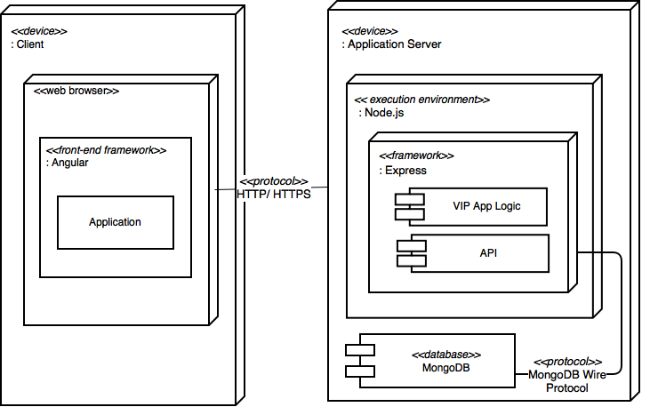
System Design: Architecture
HARDWARE SPECS:
(Production Server)
Quad core 2GHz CPU, 200GB HDD, 4GB RAM
OS: Ubuntu Linux 14.04
Notes:
20 seconds
System design: Highlight the parts that you contributed to them.
2. System deployment – h/w and s/w requirements

Slide 7
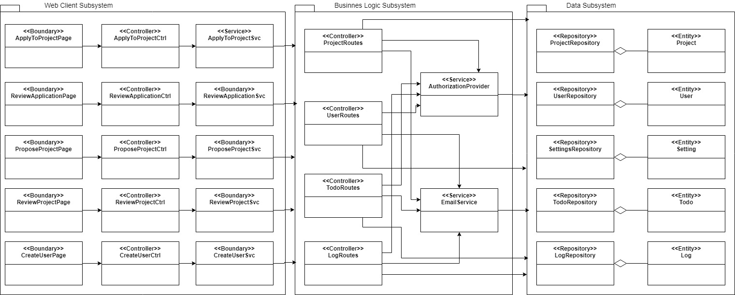
Minimal Class Diagram
Notes:
10 seconds.Minimal class diagram. Highlight the classes that you created/modified
Identify the design patterns used (one or more slides).
Main design Patterns used were facade(Service classes in the frontend) and repository(Data Subsystem)

Slide 8
User Stories
Allow admin to impersonate / login as other users
2. Securing the API
3. General performance improvements
4. Enhance alert / to-do system
5. Allow admin to modify email settings
Notes:
5 seconds.
List the user stories that you worked on them.(put in order of importance). Stay focused on the parts that you have been working.
-Impersonation
-Securing the api
-Performance improvements
-To-do system enhancement
-Admin email settings

Slide 9
User Story #1: Allow Admin to Impersonate/Login as Other Users
Modified Login and Logoff request handlers
Took advantage of PassportJS
Identify impersonations by Session Id
Store impersonation sessions in Mongo
Logoff different meaning with impersonation
Main Problem:
How not to force Admin to Logoff-Login again after Impersonation in a safe manner.
Notes:
60 seconds
The tile of user story
The most important user story you worked on it. You have to describe this one very well and be proud of that.
Please present and show the complexity of your work, code, algorithms, and technical challenges and technologies you have used. (you could use screenshot if you want. Visual presentations are better than text presentation)
Go into the details of the most important/significant tasks using bullet lists or visual graphs or state chart diagram
Sequence Diagram for this user story is mandatory (in another separate page if required)
Demo using screenshots or GIF (in another separate page if required)

Slide 10
User Story #1: Allow Admin to Impersonate/Login as Other Users
Notes:
60 seconds
The tile of user story
The most important user story you worked on it. You have to describe this one very well and be proud of that.
Please present and show the complexity of your work, code, algorithms, and technical challenges and technologies you have used. (you could use screenshot if you want. Visual presentations are better than text presentation)
Go into the details of the most important/significant tasks using bullet lists or visual graphs or state chart diagram
Sequence Diagram for this user story is mandatory (in another separate page if required)
Demo using screenshots or GIF (in another separate page if required)

Slide 11
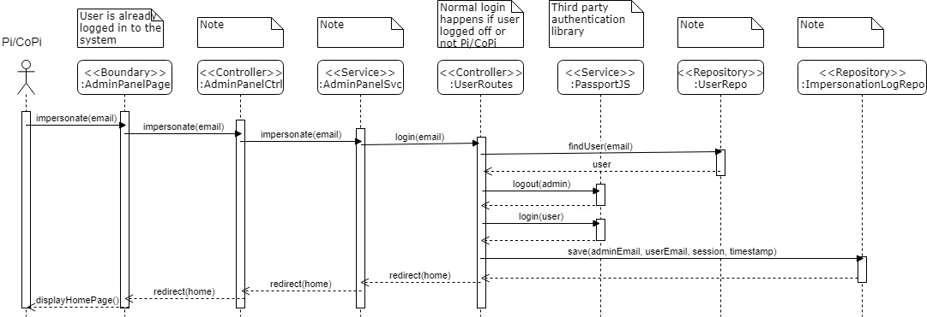
User Story #1: Allow Admin to Impersonate/Login as Other Users
Notes:
60 seconds
The tile of user story
The most important user story you worked on it. You have to describe this one very well and be proud of that.
Please present and show the complexity of your work, code, algorithms, and technical challenges and technologies you have used. (you could use screenshot if you want. Visual presentations are better than text presentation)
Go into the details of the most important/significant tasks using bullet lists or visual graphs or state chart diagram
Sequence Diagram for this user story is mandatory (in another separate page if required)
Demo using screenshots or GIF (in another separate page if required)

Slide 12
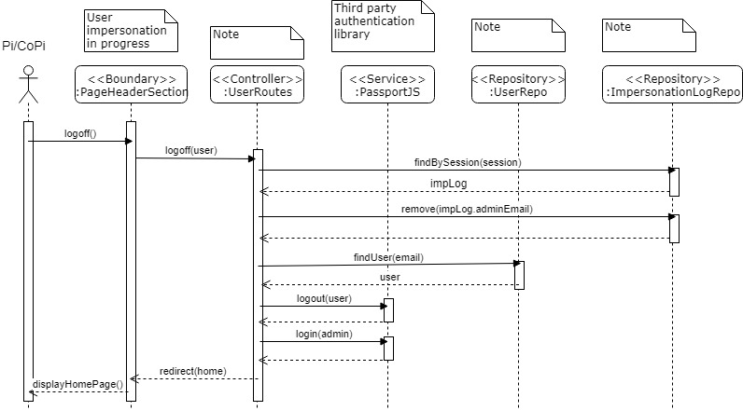
User Story #1: Allow Admin to Impersonate/Login as Other Users
Notes:
60 seconds
The tile of user story
The most important user story you worked on it. You have to describe this one very well and be proud of that.
Please present and show the complexity of your work, code, algorithms, and technical challenges and technologies you have used. (you could use screenshot if you want. Visual presentations are better than text presentation)
Go into the details of the most important/significant tasks using bullet lists or visual graphs or state chart diagram
Sequence Diagram for this user story is mandatory (in another separate page if required)
Demo using screenshots or GIF (in another separate page if required)

Slide 13
User Story #2: Secure the API
Problem:
No authorization at the api level
Anyone could get all user information or create/delete a project
Solution:
Reusable Express middleware functions
Authorization by user type, project owner, student affected, etc…
Simple to use and extend
Notes:
20 seconds
The tile of user story
Please present and show the complexity of your work, code, algorithms, and technical challenges and technologies you have used. (you could use screenshot if you want. Visual presentations are better than text presentation) - Go into the details of the most important/significant tasks using bullet lists or visual graphs or state chart diagram - Demo using screenshots or GIF (in another separate page if required)
Sequence Diagram for this user story is optional

Slide 14
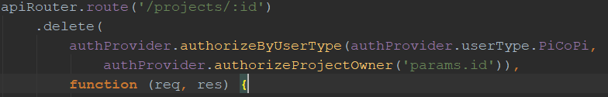
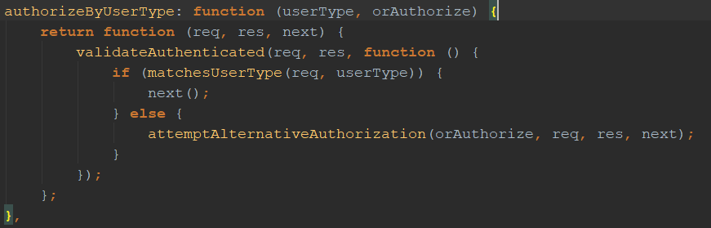
User Story #2: Secure the API
Notes:
20 seconds
The tile of user story
Please present and show the complexity of your work, code, algorithms, and technical challenges and technologies you have used. (you could use screenshot if you want. Visual presentations are better than text presentation) - Go into the details of the most important/significant tasks using bullet lists or visual graphs or state chart diagram - Demo using screenshots or GIF (in another separate page if required)
Sequence Diagram for this user story is optional

Slide 15
User Story #3: Performance Improvements
Changed:
Caching enabled(likely the biggest issue)
Mongo connection pool size increased
Combine and Minimize JS and CSS
Gulp tasks
Files generated on server startup
Reduced number of requests by 60-70 on reload
Remaining:
Unnecessarily large responses from some api calls
Notes:
20 seconds
The tile of user story
Please present and show the complexity of your work, code, algorithms, and technical challenges and technologies you have used. (you could use screenshot if you want. Visual presentations are better than text presentation) - Go into the details of the most important/significant tasks using bullet lists or visual graphs or state chart diagram - Demo using screenshots or GIF (in another separate page if required)
Sequence Diagram for this user story is optional

Slide 16
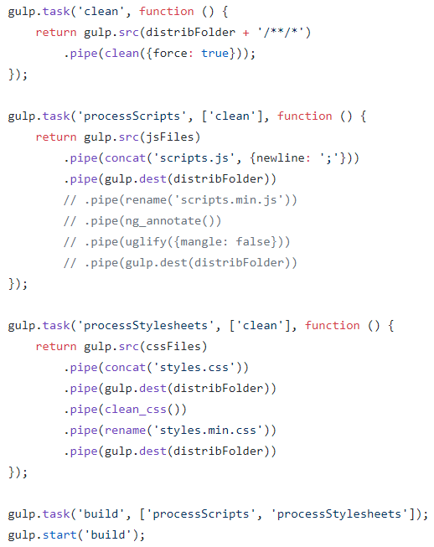
User Story #3: Performance Improvements
Notes:
20 seconds
The tile of user story
Please present and show the complexity of your work, code, algorithms, and technical challenges and technologies you have used. (you could use screenshot if you want. Visual presentations are better than text presentation) - Go into the details of the most important/significant tasks using bullet lists or visual graphs or state chart diagram - Demo using screenshots or GIF (in another separate page if required)
Sequence Diagram for this user story is optional

Slide 17
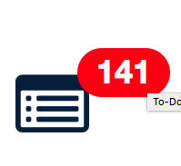

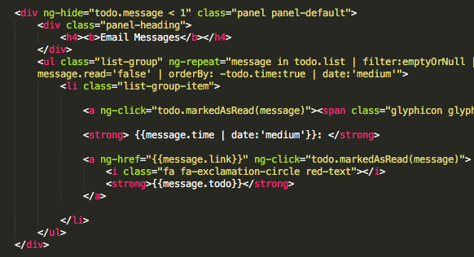
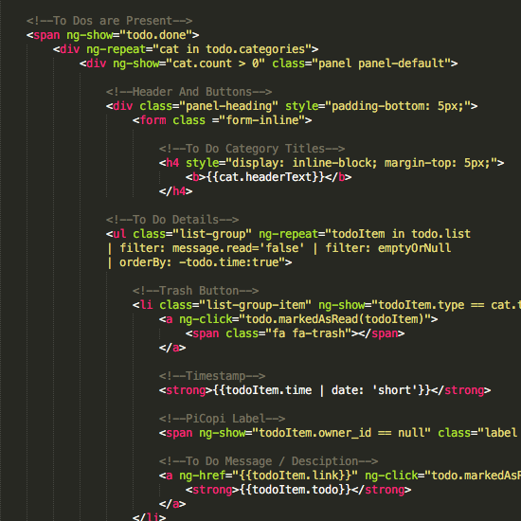
User Story #4: Enhance to-do system
PROBLEM
SOLUTION
API query optimization
Leveraging Angular ng-repeat directive to eliminate repetitive markup
Poor management!
Unoptimized code
5x
1x
Original code, which consists of five similarly structured blocks.
Notes:
20 seconds
The tile of user story
Please present and show the complexity of your work, code, algorithms, and technical challenges and technologies you have used. (you could use screenshot if you want. Visual presentations are better than text presentation) - Go into the details of the most important/significant tasks using bullet lists or visual graphs or state chart diagram - Demo using screenshots or GIF (in another separate page if required)
Sequence Diagram for this user story is optional

Slide 18
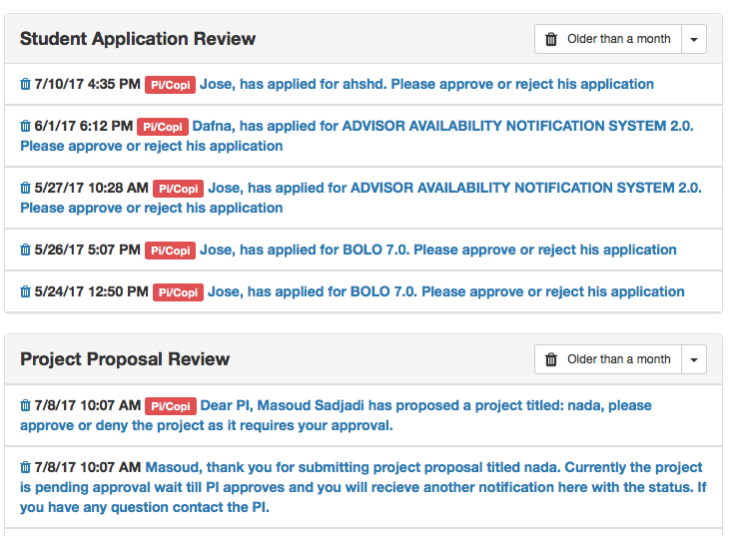
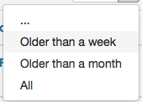
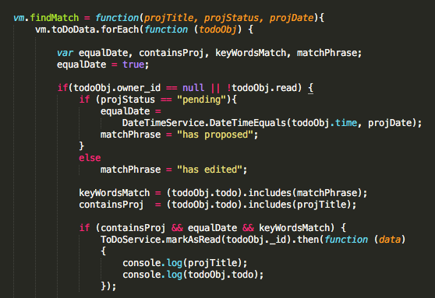
User Story #4: Enhance to-do system
NEW FEATURES
Clear to-dos in bulk
Auto-removal of to-dos when associated tasks are completed
(Top) To-Do Inbox, new “Clear” button with drop-down options
(Left) matching algorithm

Slide 19
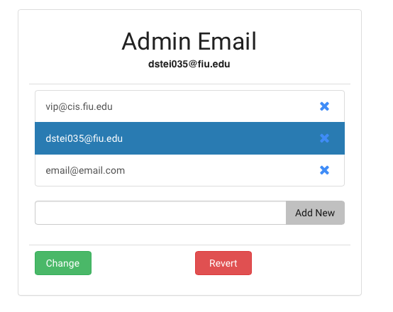
User Story #5: Allow admin to modify email settings
PROBLEM
Admin e-mail address hard-coded in software and inaccessible through app
Admin email pane on Admin Panel. Selected entry indicates active e-mail
SOLUTION
New “settings” database collection and API
Introduce interface to access settings via GUI

Slide 20
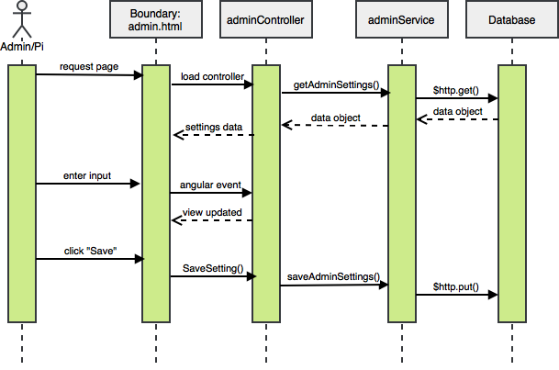
User Story #5: Allow admin to modify email settings
IMPLEMENTATION
Admin email fetched from, saved to DB “settings” collection.
No more hard-coded values!
Notes:
20 seconds
The tile of user story
Please present and show the complexity of your work, code, algorithms, and technical challenges and technologies you have used. (you could use screenshot if you want. Visual presentations are better than text presentation) - Go into the details of the most important/significant tasks using bullet lists or visual graphs or state chart diagram - Demo using screenshots or GIF (in another separate page if required)
Sequence Diagram for this user story is optional

Slide 21

Test Suites and Test Cases
VIP-1272-U1 (Sunny Day)
Description/Summary of Test: Deleting to-do notifications older than one week of age.
Pre-condition:
There EXISTS at least one (1) to-do belon ging to the user that is seven (7) days or older.
Expected Results:
All to-dos aged seven (7) days and older from the selected category are removed from the to-do inbox. Deletion persists when the to-do inbox is refreshed.
Status: PASS
VIP-1272-U2 (Rainy Day)
Description/Summary of Test:
Attempting deletion of to-do notifications older than one week of age when no such to-dos exist.
Pre-condition:
There exists at least one (1) to-do belonging to the user. There DOES NOT EXIST a todo seven (7) days or older.
Expected Results:
No (0) todos are deleted from the inbox. System continues to run as normal, does not crash and throws no errors.
Status: PASS
Automated tests running on Selenium software-testing framework and written in Java.
Notes:
10 seconds
A description of verification process and Test Suites and Test Cases for one of the use cases.
1 One sunny day and one rainy day for the implemented use cases (one or more slides).
2 Automated test scripts for the implemented use cases (if any) (one or more slides).

Slide 22
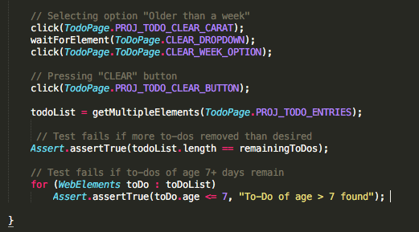
Sample Test Script
GUI controls are identified
and selected for
manipulation using
the web element’s xpath
TodoPage.PROJ_TODO_CLEAR_BUTTON =
By.xpath(“/html/body/div/div/div/span/div[5]/div/div/form/div/button[1]”);
JUnit “assert” statements determine whether tests
pass, or whether they
fail with a message.
Selenium WebDriver opens a new instance of the web browser. Test script written in Java provides driver with execution instructions.
Notes:
Still needs to be done, will probably mock up some “assertTrue” / “assertFalse” statements to demonstrate how validation is coded.

Slide 23











Summary
Jose Diaz
jponc021@fiu.edu
Dafna Steinberg
dstei035@fiu.edu
Questions?
Thank You!
Notes:
10 seconds
Summarize your contribution, mention your effort for Scrum, Mingle, Github, Google Drive Documentation and minutes (VERBAL)
Include your contact information
Ask if anyone has any questions for you.
Thank your audience

